Slide 1
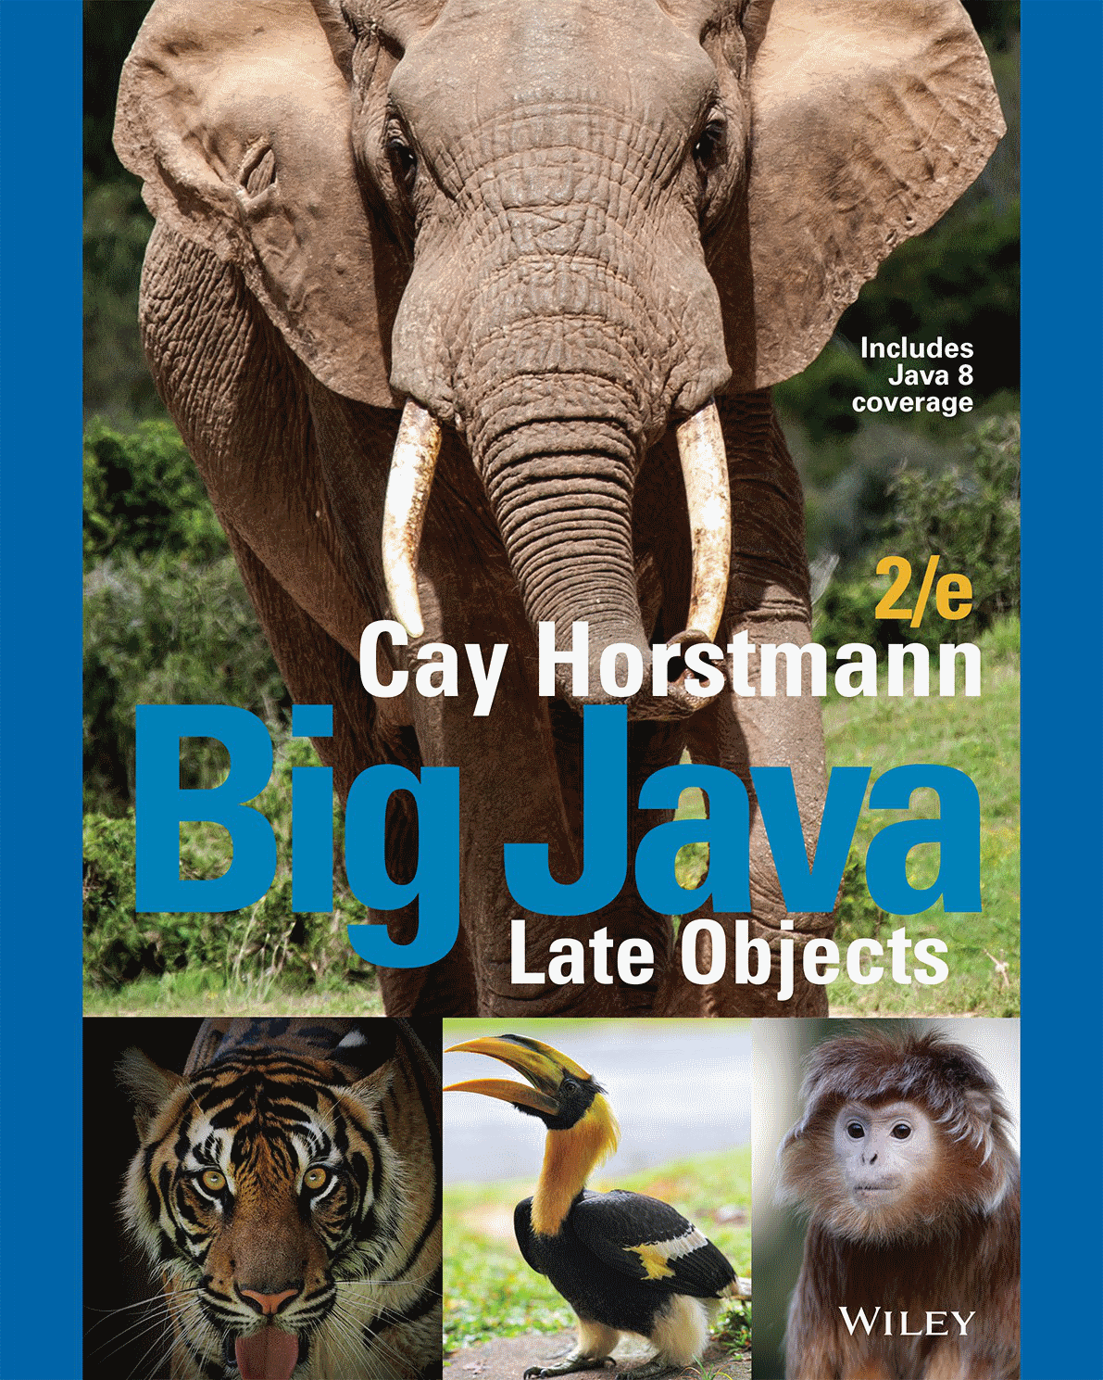
Chapter 6 – Arrays and Array Lists

Slide 2

Chapter Goals
To collect elements using arrays and array lists
To use the enhanced for loop for traversing arrays and array lists
To learn common algorithms for processing arrays and array lists
To work with two-dimensional arrays

Slide 3

Arrays
A Computer Program often needs to store a list of values and then process them
For example, if you had this list of values, how many variables would you need?
  double input1, input2, input3….
Arrays to the rescue!
An array collects sequences of values of the same type

Slide 4
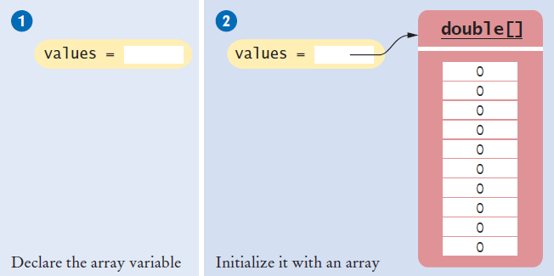
Declaring an Array
Declaring an array is a two step process
  double[] values; // declare array variable
  values = new double[10]; // initialize array
You cannot use the array until you tell the compiler the size of the array in step 2.

Slide 5
Declaring and Initializing an Array
You can declare and set the initial contents of all elements by:
  Type Braces Array name Contents list Semicolon
  int [ ] primes = { 2, 3, 5, 7} ;
You are declaring that
  There is an array named primes
  The elements inside are of type int
  Reserve space for four elements
    The compiler counts them for you!
  Set initial values to 2, 3, 5, and 7
  Note the curly braces around the contents list

Slide 6
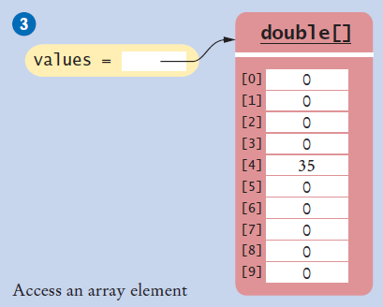
Accessing Array Elements
Each element is numbered
  We call this the index
  Access an element by:
    Name of the array
    Index number
    values[i]
public static void main(String[] args)
{
double values[];
values = new double[10];
values[4] = 35;
}

Slide 7
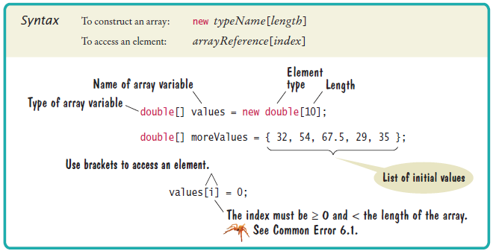
Syntax 6.1 Array

Slide 8
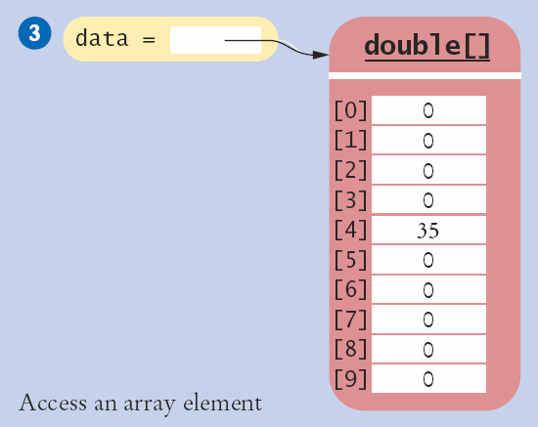
Array Index Numbers
Array index numbers start at 0
  The rest are positive integers
A 10 element array has indices 0 through 9
  There is NO element 10!
The first element is at index 0:
public static void main(String[] args)
{
double values[];
values = new double[10];
}
The last element is at index 9 :

Slide 9
Array Bounds Checking
An array knows how many elements it can hold
  values.length is the size of the array named values
  It is an integer value (index of the last element + 1)
Use this to range check and prevent bounds errors
public static void main(String[] args)
{
int i = 10, value = 34;
double values[];
values = new double[10];
if (0 <= i && i < values.length) // length is 10
{
value[i] = value;
}
}
Strings and arrays use different syntax to find their length:
Strings: name.length()
Arrays: values.length

Slide 10
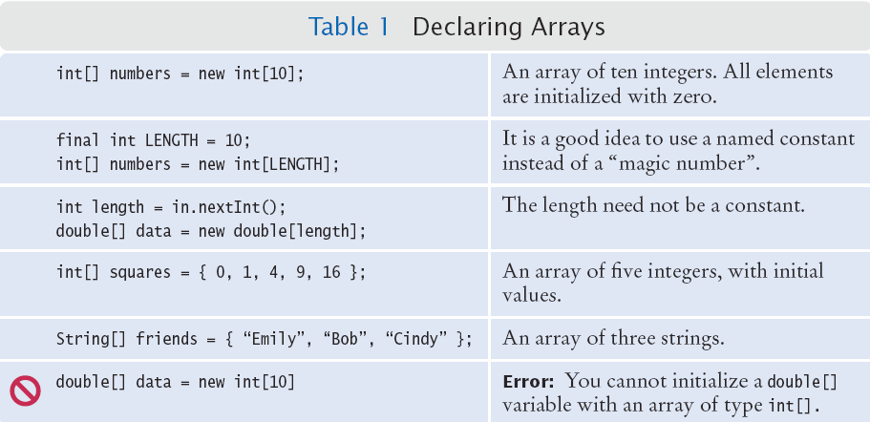
Summary: Declaring Arrays

Slide 11
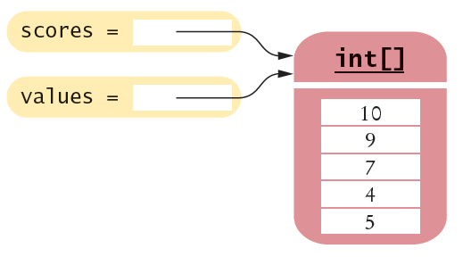
Array Aliases
You can make one array reference refer to the same contents of another array reference:
int[] scores = { 10, 9, 7, 4, 5 };
Int[] values = scores; // Copying the array reference
Array contents
References
An array variable specifies the location of an array. Copying the reference yields a second reference to the same array.

Slide 12
Self Check 6.1
Declare an array of integers containing the first five prime numbers.
Answer: int[] primes = { 2, 3, 5, 7, 11 };

Slide 13
Self Check 6.2
Assume the array primes has been initialized as described in Self Check 1. What does it contain after executing the following loop?
  for (int i = 0; i < 2; i++)
  {
  primes[4 - i] = primes[i];
  }
Answer: 2, 3, 5, 3, 2

Slide 14
Self Check 6.3
Assume the array primes has been initialized as described in Self Check 1. What does it contain after executing the following loop?
  for (int i = 0; i < 5; i++)
  {
  primes[i]++;
  }
Answer: 3, 4, 6, 8, 12

Slide 15
Self Check 6.5
Declare an array called words that can hold ten elements of type String.
Answer: String[] words = new String[10];

Slide 16
Self Check 6.6
Declare an array containing two strings, "Yes", and "No".
Answer: String[] words = { "Yes", "No" };

Slide 17
Common Error
Array Bounds Errors
  Accessing a nonexistent element is very common error
  Array indexing starts at 0
  Your program will abnormally end at run time
public class OutOfBounds
{
public static void main(String[] args)
{
double values[];
values = new double[10];
values[10] = 100;
}
}
The is no element 10:
java.lang.ArrayIndexOutOfBoundsException: 10
at OutOfBounds.main(OutOfBounds.java:7)

Slide 18
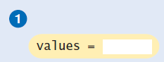

Common Error
Uninitialized Arrays
  Don’t forget to initialize the array variable!
  The compiler will catch this error
double[] values;
...
values[0] = 29.95; // Error—values not initialized
Error: D:\Java\Unitialized.java:7:
variable values might not have been initialized
double[] values;
values = new double[10];
values[0] = 29.95; // No error

Slide 19
The Enhanced for Loop
Using for loops to ‘walk’ arrays is very common
  The enhanced for loop simplifies the process
  Also called the “for each” loop
  Read this code as:
    “For each element in the array”
As the loop proceeds, it will:
  Access each element in order (0 to length-1)
  Copy it to the element variable
  Execute loop body
Not possible to:
  Change elements
  Get bounds error
double[] values = . . .;
double total = 0;
for (double element : values)
{
total = total + element;
}

Slide 20
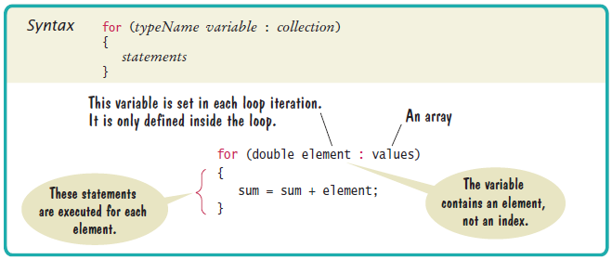
Syntax 6.2 The Enhanced for loop

Slide 21
Self Check 6.9
Write an enhanced for loop that prints all elements in the array values.
Answer:
  for (double x : values)
  {
  System.out.println(x);
  }

Slide 22
Self Check 6.10
Write an enhanced for loop that multiplies all elements in a double[] array named factors, accumulating the result in a variable named product.
Answer:
  double product = 1;
  for (double f : factors)
  {
  product = product * f;
  }

Slide 23
Common Array Algorithms
Filling an Array
Sum and Average Values
Find the Maximum or Minimum
Output Elements with Separators
Linear Search
Removing an Element
Inserting an Element
Swapping Elements
Copying Arrays
Reading Input

Slide 24
Common Algorithms 1 and 2
1) Filling an Array
  Initialize an array to a set of calculated values
  Example: Fill an array with squares of 0 through 10
2) Sum and Average
  Use enhanced for loop, and make sure not to divide by zero
int[] values = new int[11];
for (int i = 0; i < values.length; i++)
{
values[i] = i * i;
}
double total = 0, average = 0;
for (double element : values)
{
total = total + element;
}
if (values.length > 0) {
average = total / values.length;
}

Slide 25
Common Algorithms 3
Maximum and Minimum
  Set largest to first element
  Use for or enhanced for loop
  Use the same logic for minimum
double largest = values[0];
for (int i = 1; i < values.length; i++)
{
if (values[i] > largest)
{
largest = values[i];
}
}
Typical for loop to find maximum
double largest = values[0];
for (double element : values)
{
if element > largest)
largest = element;
}
double smallest = values[0];
for (double element : values)
{
if element < smallest)
smallest = element;
}
Enhanced for to find maximum
Enhanced for to find minimum

Slide 26


Common Algorithms 4
Element Separators
  Output all elements with separators between them
  No separator before the first or after the last element
Handy Array method: Arrays.toString()
  Useful for debugging!
for (int i = 0; i < values.length; i++)
{
if (i > 0)
{
System.out.print(" | ");
}
System.out.print(values[i]);
}
import java.util.*;
System.out.println(Arrays.toString(values));

Slide 27
Common Algorithms 5
Linear Search
  Search for a specific value in an array
  Start from the beginning (left), stop if/when it is found
  Uses a boolean found flag to stop loop if found
int searchedValue = 100; int pos = 0;
boolean found = false;
while (pos < values.length && !found)
{
if (values[pos] == searchedValue)
{
found = true;
}
else
{
pos++;
}
if (found)
{
System.out.println(“Found at position: ” + pos);
}
else { System.out.println(“Not found”);
}
Compound condition to prevent bounds error if value not found.

Slide 28
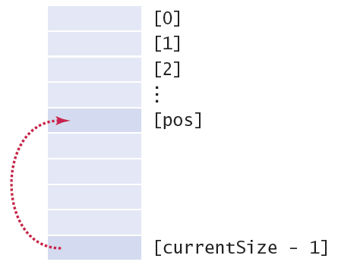
Common Algorithms 6a
Removing an element (at a given position)
  Requires tracking the ‘current size’ (# of valid elements)
  But don’t leave a ‘hole’ in the array!
  Solution depends on if you have to maintain ‘order’
    If not, find the last valid element, copy over position, update size
values[pos] = values[currentSize – 1];
currentSize--;

Slide 29
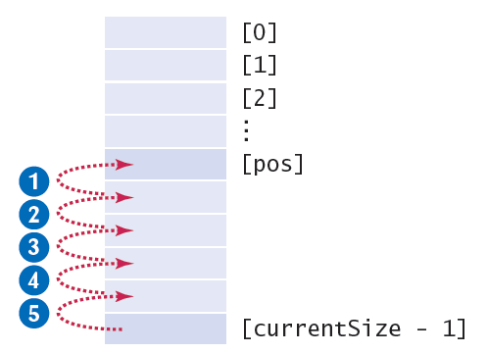
Common Algorithms 6b
Removing an element and maintaining order
  Requires tracking the ‘current size’ (# of valid elements)
  But don’t leave a ‘hole’ in the array!
  Solution depends on if you have to maintain ‘order’
    If so, move all of the valid elements after pos up one spot, update size
for (int i = pos; i < currentSize - 1; i++)
{
values[i] = values[i + 1];
}
currentSize--;

Slide 30
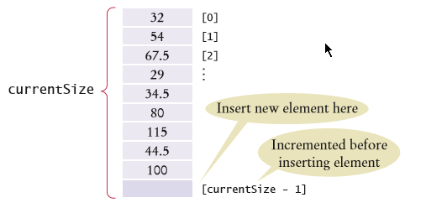
Common Algorithms 7
Inserting an Element
  Solution depends on if you have to maintain ‘order’
    If not, just add it to the end and update the size
if (currentSize < values.length)
{ currentSize++;
for (int i = currentSize - 1; i > pos; i--)
{
values[i] = values[i - 1];
}
values[pos] = newElement;
}

Slide 31
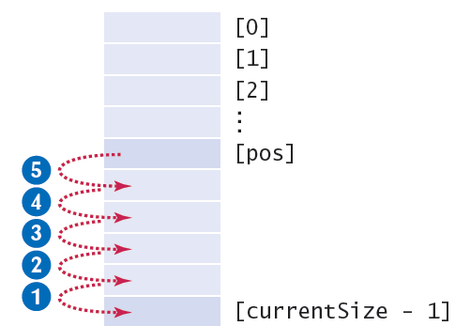
Common Algorithms 7
Inserting an Element
  Solution depends on if you have to maintain ‘order’
    If so, find the right spot for the new element, move all of the valid elements after ‘pos’ down one spot, insert the new element, and update size
if (currentSize < values.length)
{
currentSize++;
for (int i = currentSize - 1; i > pos; i--)
{
values[i] = values[i - 1]; // move down
}
values[pos] = newElement; // fill hole
}

Slide 32
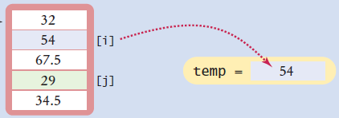
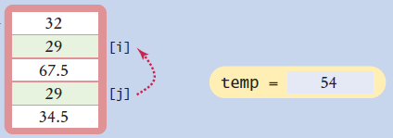
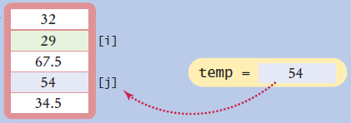
Common Algorithms 8
Swapping Elements
  Three steps using a temporary variable
double temp = values[i];
values[i] = values[j];
Values[j] = temp;

Slide 33
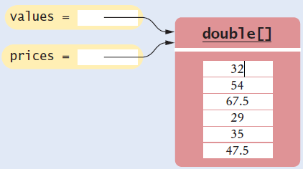
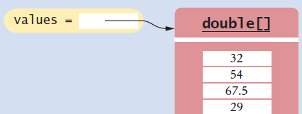
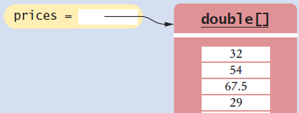
Common Algorithms 9a
Copying Arrays
  Not the same as copying only the reference
    Copying creates two set of contents!
  Use the Arrays.copyOf method
double[] values = new double[6];
. . . // Fill array
double[] prices = values; // Only a reference so far
double[] prices = Arrays.copyOf(values, values.length);
// copyOf creates the new copy, returns a reference

Slide 34
Common Algorithms 9b
Growing an array
  Copy the contents of one array to a larger one
  Change the reference of the original to the larger one
Example: Double the size of an existing array
  Use the Arrays.copyOf method
  Use 2 * in the second parameter
double[] values = new double[6];
. . . // Fill array
double[] newValues = Arrays.copyOf(values, 2 * values.length);
values = newValues;
Arrays.copyOf second parameter is the length of the new array

Slide 35
Common Algorithms 10
Reading Input
  A: Known number of values to expect
    Make an array that size and fill it one-by-one
  B: Unknown number of values
    Make maximum sized array, maintain as partially filled array
double[] inputs = new double[NUMBER_OF_INPUTS];
for (i = 0; i < values.length; i++)
{
inputs[i] = in.nextDouble();
}
double[] inputs = new double[MAX_INPUTS];
int currentSize = 0;
while (in.hasNextDouble() && currentSize < inputs.length)
{
inputs[currentSize] = in.nextDouble();
currentSize++;
}

Slide 36
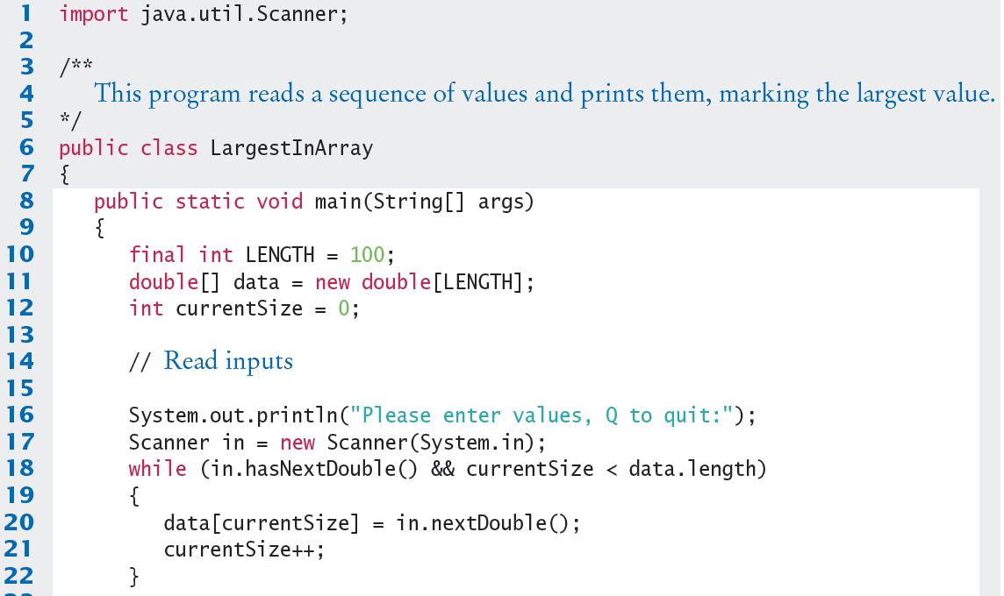
LargestInArray.java (1)
Input values and store in next available index of the array

Slide 37
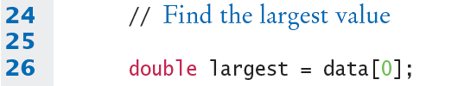
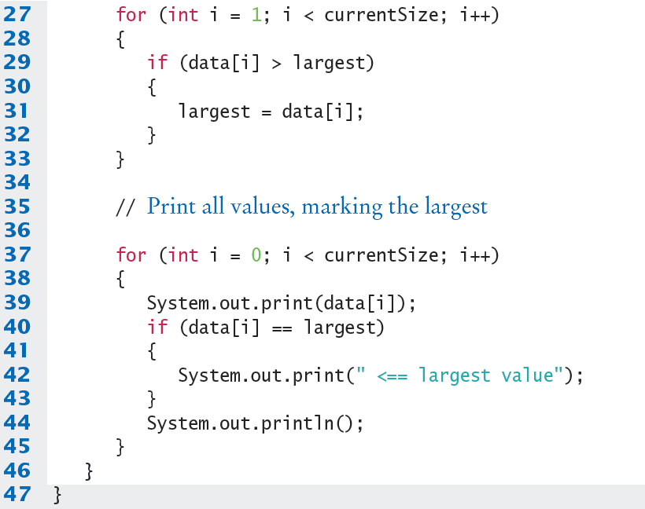
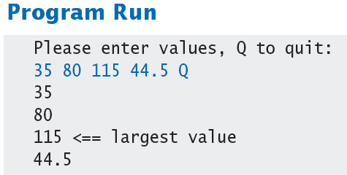
LargestInArray.java (2)
Use a for loop and the ‘Find the largest’ algorithm

Slide 38


Special Topic: Sorting Arrays
When you store values into an array, you can choose to either:
  Keep them unsorted (random order)
  Sort them (Ascending or Descending…)
A sorted array makes it much easier to find a specific value in a large data set
The Java API provides an efficient sort method:
Arrays.sort(values); // Sort all of the array
Arrays.sort(values, 0, currentSize); // partially filled

Slide 39
Special Topic: Searching
We have seen the Linear Search (6.3.5)
  It works on an array that is sorted, or unsorted
  Visit each element (start to end), and stop if you find a match or find the end of the array
Binary Search
  Only works for a sorted array
  Compare the middle element to our target
    If it is lower, exclude the lower half
    If it is higher, exclude the higher half
  Do it again until you find the target or you cannot split what is left

Slide 40




Binary Search
Binary Search
  Only works for a sorted array
  Compare the middle element to our target
    If it is lower, exclude the lower half
    If it is higher, exclude the higher half
    Do it again until you find the target or you cannot split what is left
  Example: Find the value 15
    Sorry, 15 is not in this array.

Slide 41
Binary Search Example
boolean found = false, int low = 0, int pos = 0;
int high = values.length - 1;
while (low <= high && !found)
{
pos = (low + high) / 2; // Midpoint of the subsequence
if (values[pos] == searchedValue)
{ found = true; } // Found it!
else if (values[pos] < searchedValue)
{ low = pos + 1; } // Look in first half
else { high = pos - 1; } // Look in second half
}
if (found)
{ System.out.println("Found at position " + pos); }
else
{ System.out.println("Not found. Insert before position " + pos); }

Slide 42
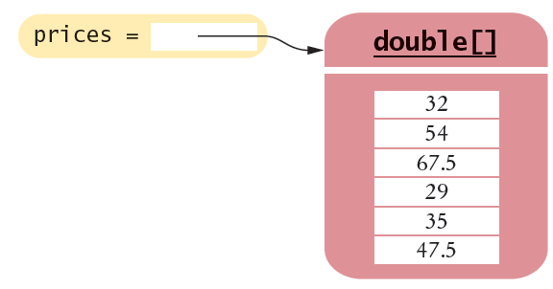
Using Arrays with Methods
Methods can be declared to receive references as parameter variables
What if we wanted to write a method to sum all of the elements in an array?
  Pass the array reference as an argument!
priceTotal = sum(prices);
reference
public static double sum(double[] values)
{
double total = 0;
for (double element : values)
total = total + element;
return total;
}
Arrays can be used as method arguments and method return values.

Slide 43
Passing References (Step 1)
Passing a reference give the called method access to all of the data elements
  It CAN change the values!
Example: Multiply each element in the passed array by the value passed in the second parameter
multiply(values, 10);
reference
value
public static void multiply(double[] data, double factor)
{
for (int i = 0; i < data.length; i++)
data[i] = data[i] * factor;
}

Slide 44
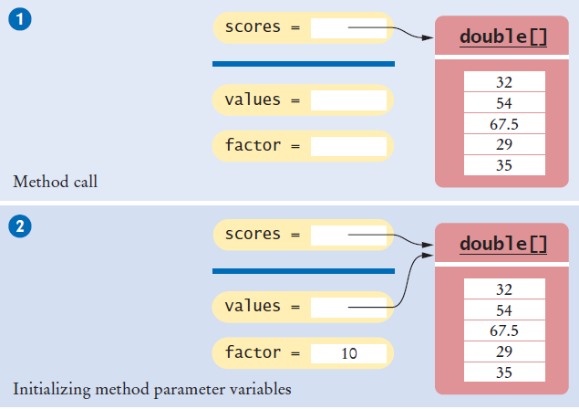

Passing References (Step 2)

Slide 45
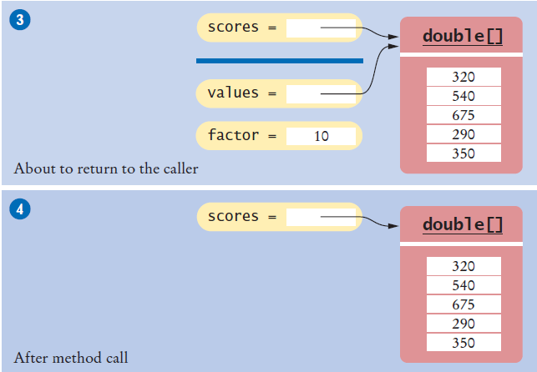
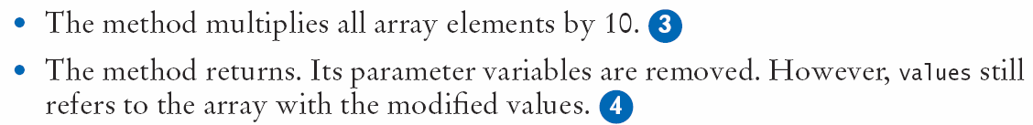
Passing References (Steps 3 & 4)

Slide 46
Method Returning an Array
Methods can be declared to return an array
To Call: Create a compatible array reference:
  Call the method
public static int[] squares(int n)
int[] numbers = squares(10);
value
public static int[] squares(int n)
{
int[] result = new int[n];
for (int i = 0; i < n; i++)
{
result[i] = i * i;
}
return result;
}
reference

Slide 47
Self Check 6.22
Consider the following method that reverses an array:
  public static int[] reverse(int[] values)
  {
  int[] result = new int[values.length];
  for (int i = 0; i < values.length; i++)
  {
  result[i] = values[values.length - 1 - i];
  }
  return result;
  }
Suppose the reverse method is called with an array scores that contains the numbers 1, 4, and 9. What is the contents of scores after the method call?
Answer: The contents of scores is unchanged. The reverse method returns a new array with the reversed numbers.

Slide 48
Using Arrays with Methods
1) Decompose the task into steps
  Read inputs.
  Remove the minimum.
  Calculate the sum.
2) Determine the algorithms to use
  Read inputs.
  Find the minimum.
  Find the position of the minimum.
  Remove the element at the position.
  Calculate the sum.
3) Use methods to structure the program
4) Assemble and test the program
double[] scores = readInputs();
double total = sum(scores) - minimum(scores);
System.out.println("Final score: " + total);

Slide 49
Multi-Dimensional Arrays

Slide 50
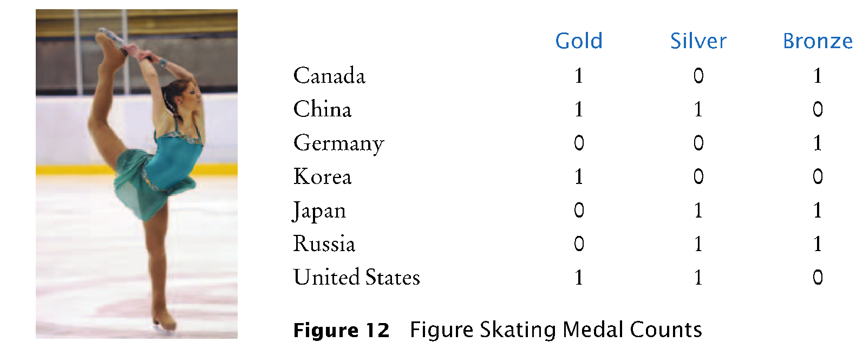
Two-Dimensional Arrays
Arrays can be used to store data in two dimensions (2D) like a spreadsheet
  Rows and Columns
  Also known as a ‘matrix’

Slide 51
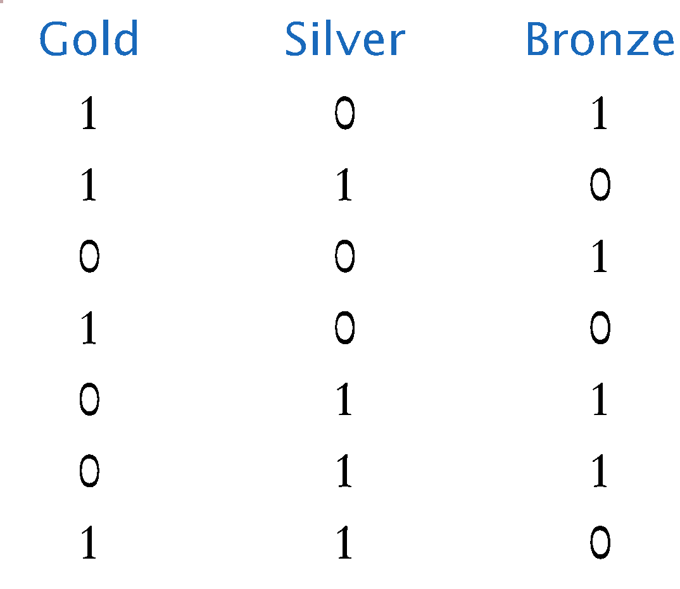
Declaring Two-Dimensional Arrays
Use two ‘pairs’ of square braces
You can also initialize the array
const int COUNTRIES = 7;
const int MEDALS = 3;
int[][] counts = new int[COUNTRIES][MEDALS];
const int COUNTRIES = 7;
const int MEDALS = 3;
int[][] counts =
{
{ 1, 0, 1 },
{ 1, 1, 0 },
{ 0, 0, 1 },
{ 1, 0, 0 },
{ 0, 1, 1 },
{ 0, 1, 1 },
{ 1, 1, 0 }
};
Note the use of two ‘levels’ of curly braces. Each row has braces with commas separating them.

Slide 52
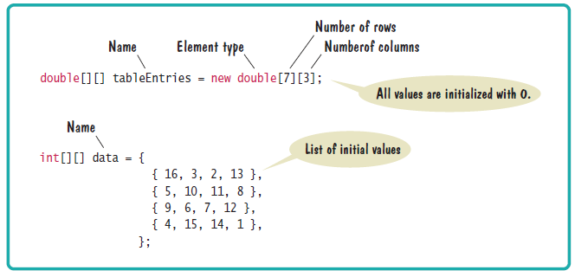
Syntax 6.3 2D Array Declaration
The name of the array continues to be a reference to the contents of the array
  Use new or fully initialize the array

Slide 53
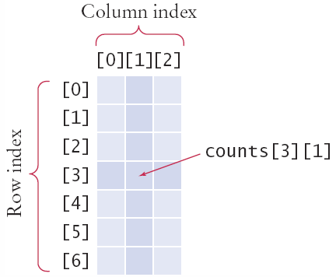
Accessing Elements
Use two index values:
  Row then Column
To print
  Use nested for loops
  Outer row(i) , inner column(j) :
int value = counts[3][1];
for (int i = 0; i < COUNTRIES; i++)
{
// Process the ith row
for (int j = 0; j < MEDALS; j++)
{
// Process the jth column in the ith row
System.out.printf("%8d", counts[i][j]);
}
System.out.println(); // Start a new line at the end of the row
}

Slide 54
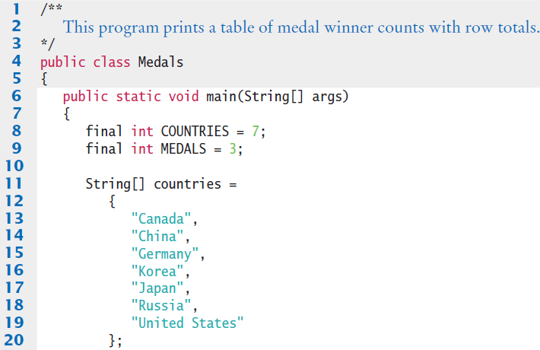
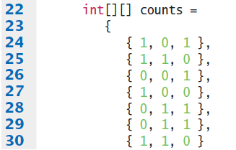
Medals.java (1)

Slide 55
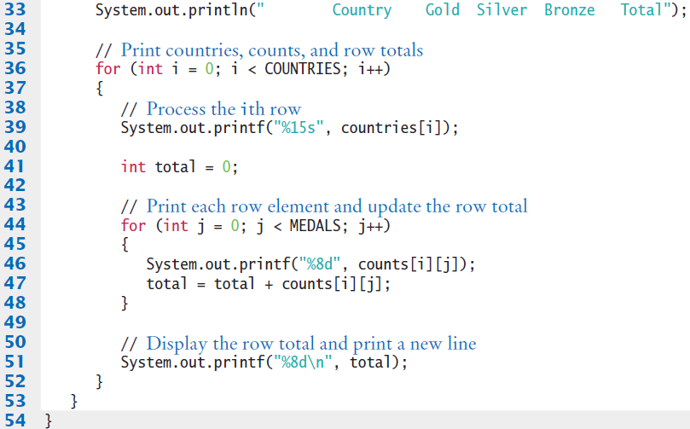
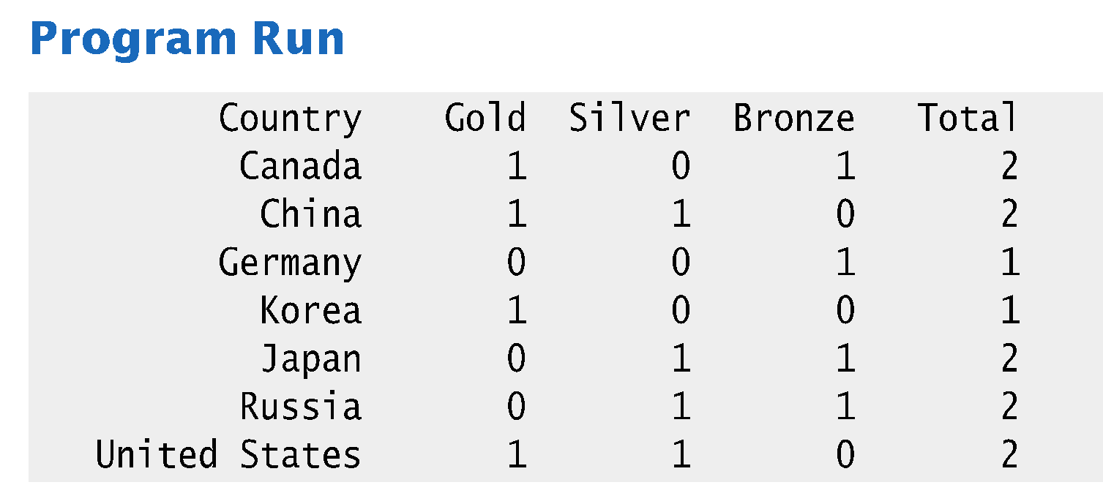
Medals.java (2)

Slide 56
ArrayList

Slide 57
Array Lists
When you write a program that collects values, you don’t always know how many values you will have.
In such a situation, a Java ArrayList offers two significant advantages:
  Array Lists can grow and shrink as needed.
  The ArrayList class supplies methods for common tasks, such as inserting and removing elements.

Slide 58
Declaring and Using Array Lists
The ArrayList class is part of the java.util package
  It is a generic class
    Designed to hold many types of objects
  Provide the type of element during declaration
    Inside < > as the ‘type parameter’
    The type must be a Class
    Cannot be used for primitive types (int, double…)
ArrayList<String> names = new ArrayList<String>();

Slide 59
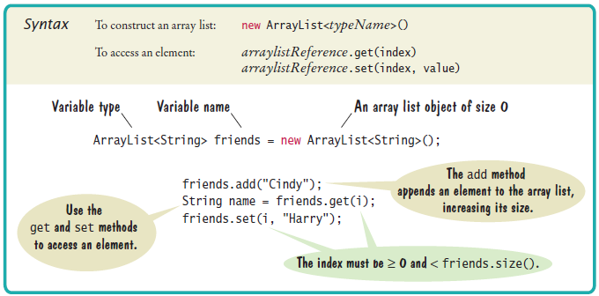
Syntax 6.4 Array Lists
ArrayList provides many useful methods:
  add: add an element
  get: return an element
  remove: delete an element
  set: change an element
  size: current length

Slide 60
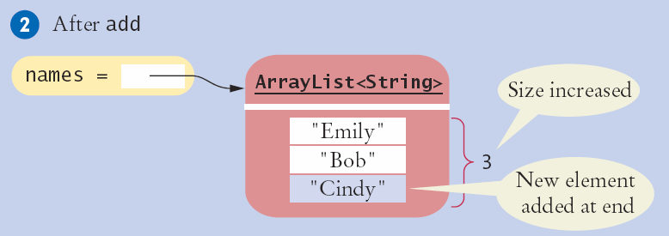
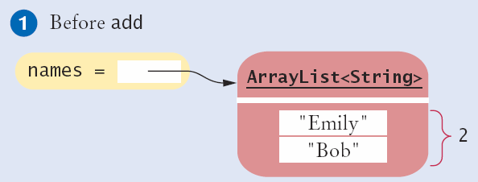
Adding an Element with add()
The add method has two versions:
  Pass a new element to add to the end
  Pass a location (index) and the new value to add
    Moves all other elements
names.add(“Cindy”);
names.add(1,“Cindy”);

Slide 61
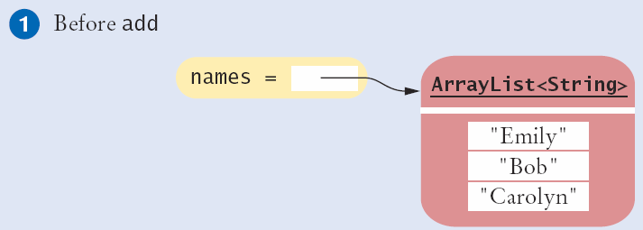
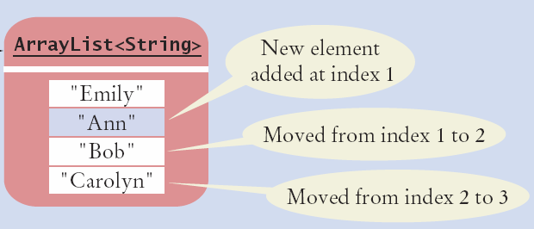
Adding an Element in the Middle
Pass a location (index) and the new value to add
  Moves all other elements
names.add(1, “Ann”);

Slide 62
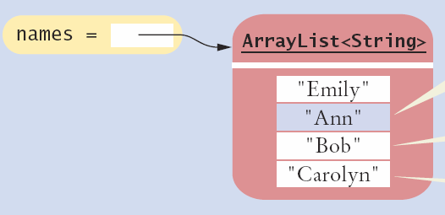
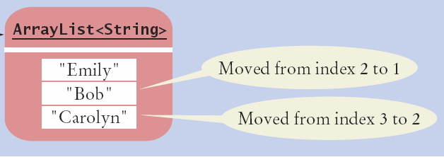
Removing an Element
Pass a location (index) to be removed
  Moves all other elements
names.remove(1);

Slide 63
Using Loops with Array Lists
You can use the enhanced for loop with Array Lists:
Or ordinary loops:
ArrayList<String> names = . . . ;
for (String name : names)
{
System.out.println(name);
}
ArrayList<String> names = . . . ;
for (int i = 0; i < names.size(); i++)
{
String name = names.get(i);
System.out.println(name);
}

Slide 64
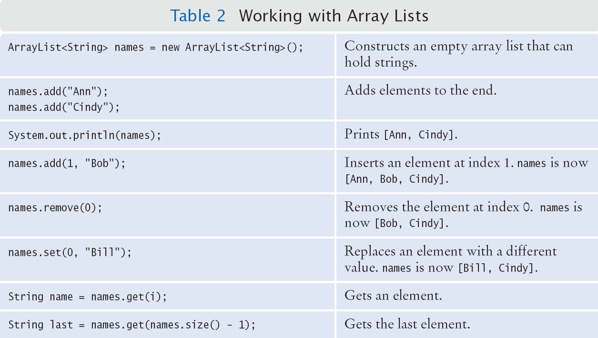
Working with Array Lists

Slide 65
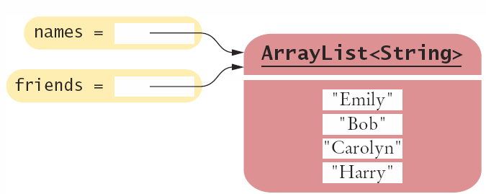
Copying an ArrayList
Remember that ArrayList variables hold a reference to an ArrayList (just like arrays)
Copying a reference:
To make a copy, pass the reference of the original ArrayList to the constructor of the new one:
ArrayList<String> friends = names;
friends.add("Harry");
reference
ArrayList<String> newNames = new ArrayList<String>(names);

Slide 66
Array Lists and Methods
Like arrays, Array Lists can be method parameter variables and return values
Here is an example: a method that receives a list of Strings and returns the reversed list
reference
public static ArrayList<String> reverse(ArrayList<String> names)
{
// Allocate a list to hold the method result
ArrayList<String> result = new ArrayList<String>();
// Traverse the names list in reverse order (last to first)
for (int i = names.size() - 1; i >= 0; i--)
{
// Add each name to the result
result.add(names.get(i));
}
return result;
}

Slide 67
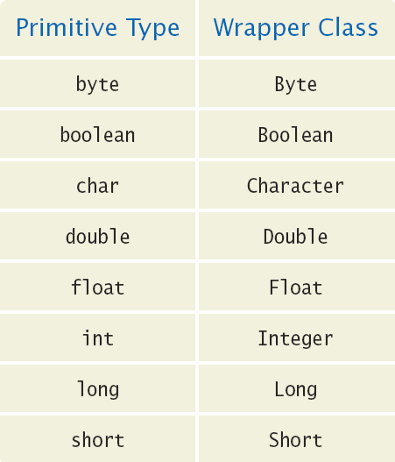
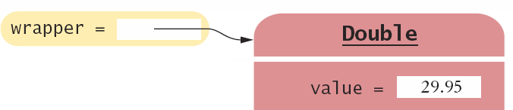
Wrappers and Auto-boxing
Java provides wrapper classes for primitive types
  Conversions are automatic using auto-boxing
    Primitive to wrapper Class
    wrapper Class to primitive
double x = 29.95;
Double wrapper;
wrapper = x; // boxing
double x;
Double wrapper = 29.95;
x = wrapper; // unboxing

Slide 68
Wrappers and Auto-boxing
You cannot use primitive types in an ArrayList, but you can use their wrapper classes
  Depend on auto-boxing for conversion
Declare the ArrayList with wrapper classes for primitive types
  Use ArrayList<Double>
    Add primitive double variables
    Or double values
double x = 19.95;
ArrayList<Double> values = new ArrayList<Double>();
values.add(29.95); // boxing
values.add(x); // boxing
double x = values.get(0); // unboxing

Slide 69
ArrayList Algorithms
Converting from Array to ArrayList requires changing:
  index usage: [i]
  values.length
To
  methods: get()
  values.size()
double largest = values[0];
for (int i = 1; i < values.length; i++)
{
if (values[i] > largest)
{
largest = values[i];
}
}
double largest = values.get(0);
for (int i = 1; i < values.size(); i++)
{
if (values.get(i) > largest)
{
largest = values.get(i);
}
}

Slide 70
Choosing Arrays or Array Lists
Use an Array if:
  The size of the array never changes
  You have a long list of primitive values
    For efficiency reasons
  Your instructor wants you to
Use an Array List:
  For just about all other cases
  Especially if you have an unknown number of input values

Slide 71
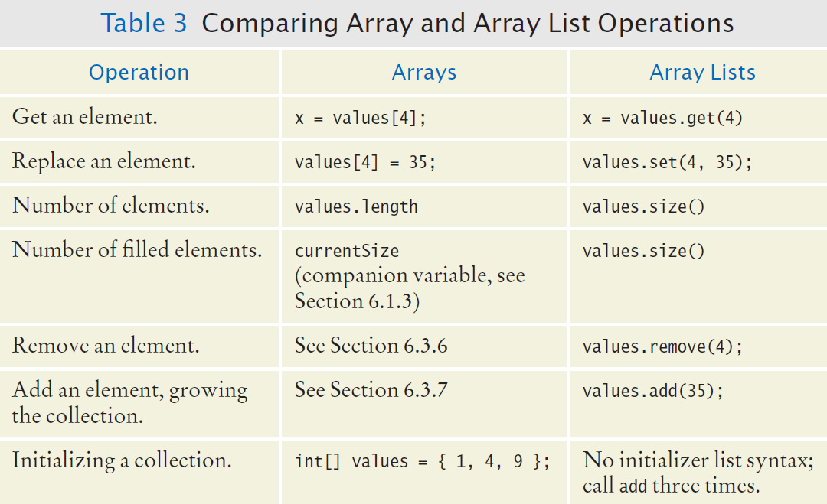
Array and Array List Operations

Slide 72
Self Check 6.39
Declare an array list primes of integers that contains the first five prime numbers (2, 3, 5, 7, and 11).
Answer:
  ArrayList<Integer> primes =
  new ArrayList<Integer>();
  primes.add(2);
  primes.add(3);
  primes.add(5);
  primes.add(7);
  primes.add(11);

Slide 73
Self Check 6.40
Given the array list primes declared in Self Check 39, write a loop to print its elements in reverse order, starting with the last element.
Answer:
  for (int i = primes.size() - 1; i >= 0; i--)
  {
  System.out.println(primes.get(i));
  }

Slide 74
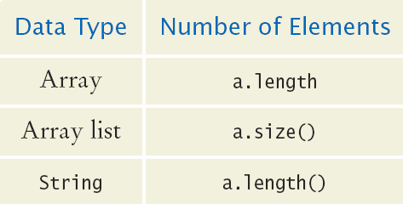
Common Error
Length versus Size
  Unfortunately, the Java syntax for determining the number of elements in an array, an ArrayList, and a String is not consistent.
  It is a common error to confuse these. You just have to remember the correct syntax for each data type.

